Slide 1
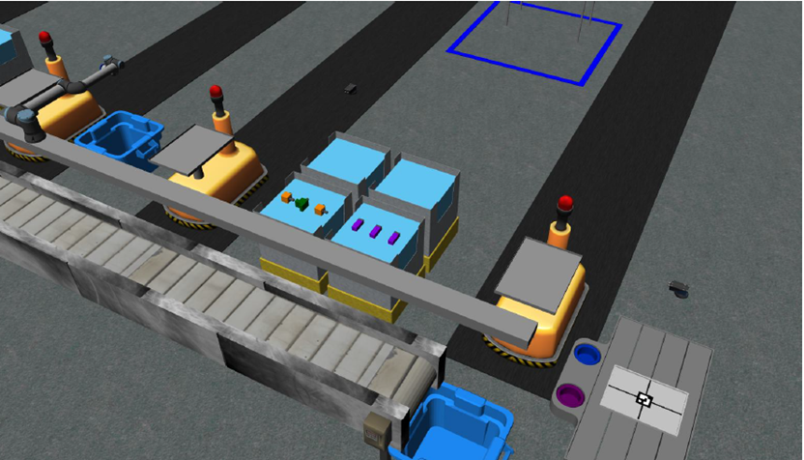
ENPM663: Building a Manufacturing Robotic Software System
RWA67
Team Members:
Shreejay Badshah
Tej Polamreddy
Ian Serbin
Arshad Shaik
Dhinesh Rajasekaran
Tim Sweeney
Notes:
Arshad

Slide 2
Table of Contents
Introduction
Problem Statement
Code Block Diagram
Environment Sensors
Order Manager
Package Contents
Trial Files
Result
Challenges Faced
How can the results be made better?
Conclusion
Demo
Notes:
Arshad

Slide 3
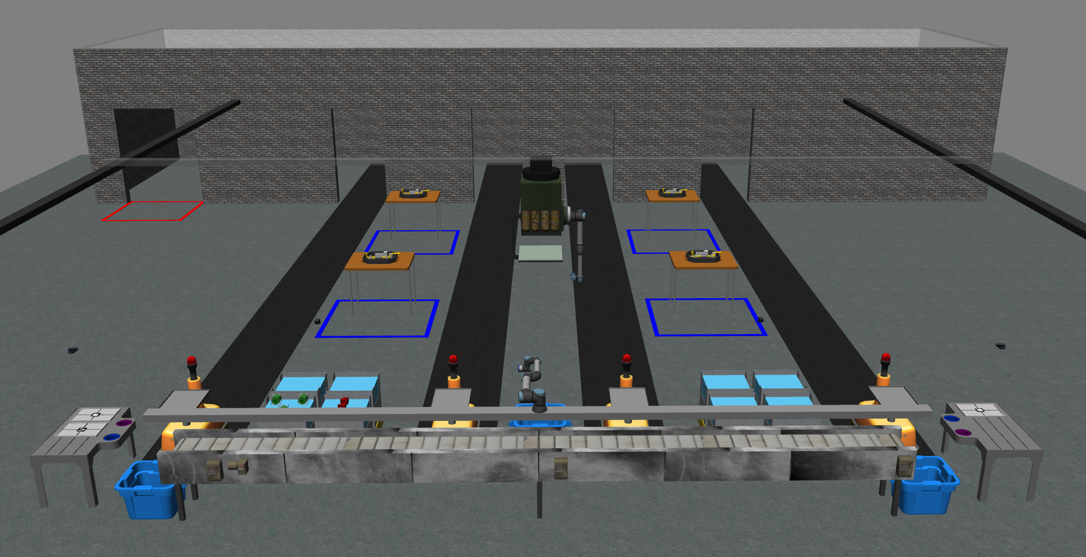
Introduction:
ARIAC is hosted by National Institute of Standards and Technology (NIST) to test the agility of the industrial robot system.
The purpose of ARIAC is to make industrial robots more autonomous, productive with minimum human input.
Notes:
Arshad

Slide 4
Problem Statement:
For this course the problem was to test the agility of an industrial floor robot to complete kitting tasks with the challenges of:
Faulty part
Parts placed in certain quadrants for the first time are deemed faulty. They must be properly disposed of in the discard bin to avoid penalty
Insufficient part
There are not enough parts to fulfill an order. The order must be complete to its fullest and still submitted.
Notes:
Arshad

Slide 5
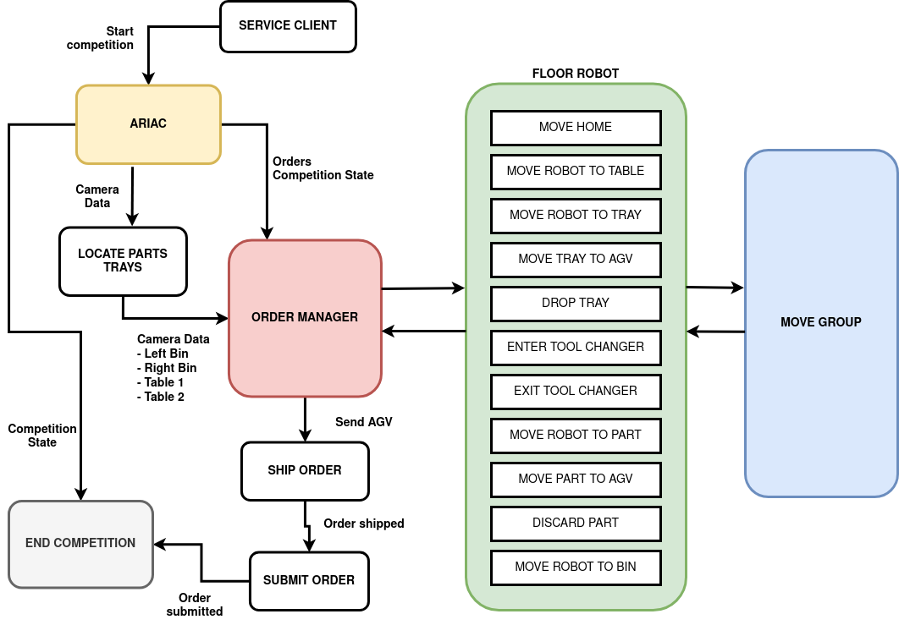
Code Block Diagram:
Notes:
Tim

Slide 6
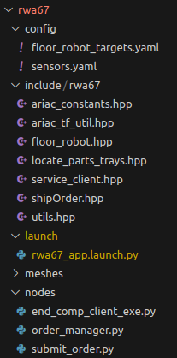
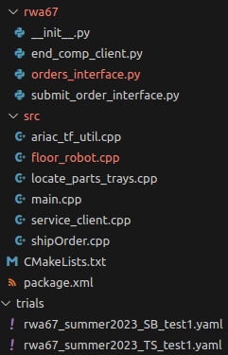
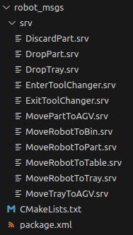
Package Contents:
Rwa67
Main Competitor Package
Robot_msgs
Custom Service Messages
Approx. Lines of code = 5053
Notes:
Tej

Slide 7
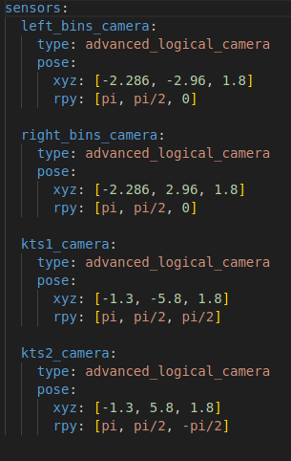
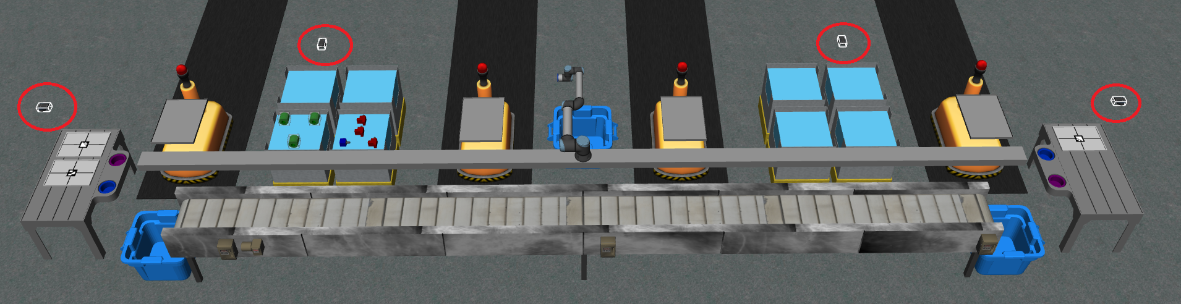
Environment Sensors:
sensors.yaml
Provide control system with information necessary to build world model
4x Advanced Logical Sensors
Provide tray id and pose
Provide part pose, color, and type
AGV Tray Sensors
Located on each AGV
Provide quality information of tray and parts
Notes:
Tej

Slide 8
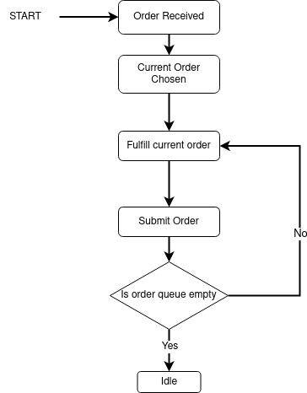
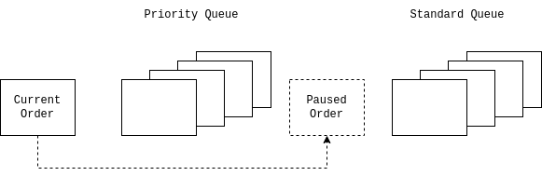
Order Manager - In Depth:
The Order Manager node is the heart of the competition package.
Subscriptions
ariac/competition_state
Begins fulfilling orders
ariac/orders
Adds orders to the queues
/left_bin_camera_data
/right_bin_camera_data
/kitting_tray1_camera_data
/kitting_tray2_camera_data
Records the poses of parts and trays. These have been obtained by locate_parts_trays, translated to world pose, then republished
Notes:
Ian

Slide 9
Order Manager - In Depth (cont.):
The Order Manager node is the heart of the competition package. It contains the main logic and makes the service requests to floor_robot
Fullfill_order:
order = current_order
tray = order.tray
agv = order.agv
tray_pose = search_tray_inventory(tray)
move_robot_to_table()
change_to_tray_gripper()
grab_tray()
place_tray_on_agv()
remove_tray_from_inventory()
move_robot_to_table()
change_to_part_gripper()
for (part in list_of_parts):
part_pose = search_part_inventory(part)
If (part_pose == None):
Continue #part not found… Moving on
place_part_on_tray()
perform_quality_check()
If (faulty):
Move part to bin
Add part back to list_of_parts
Remove_part_from_inventory()
complete_order()
Notes:
Ian

Slide 10
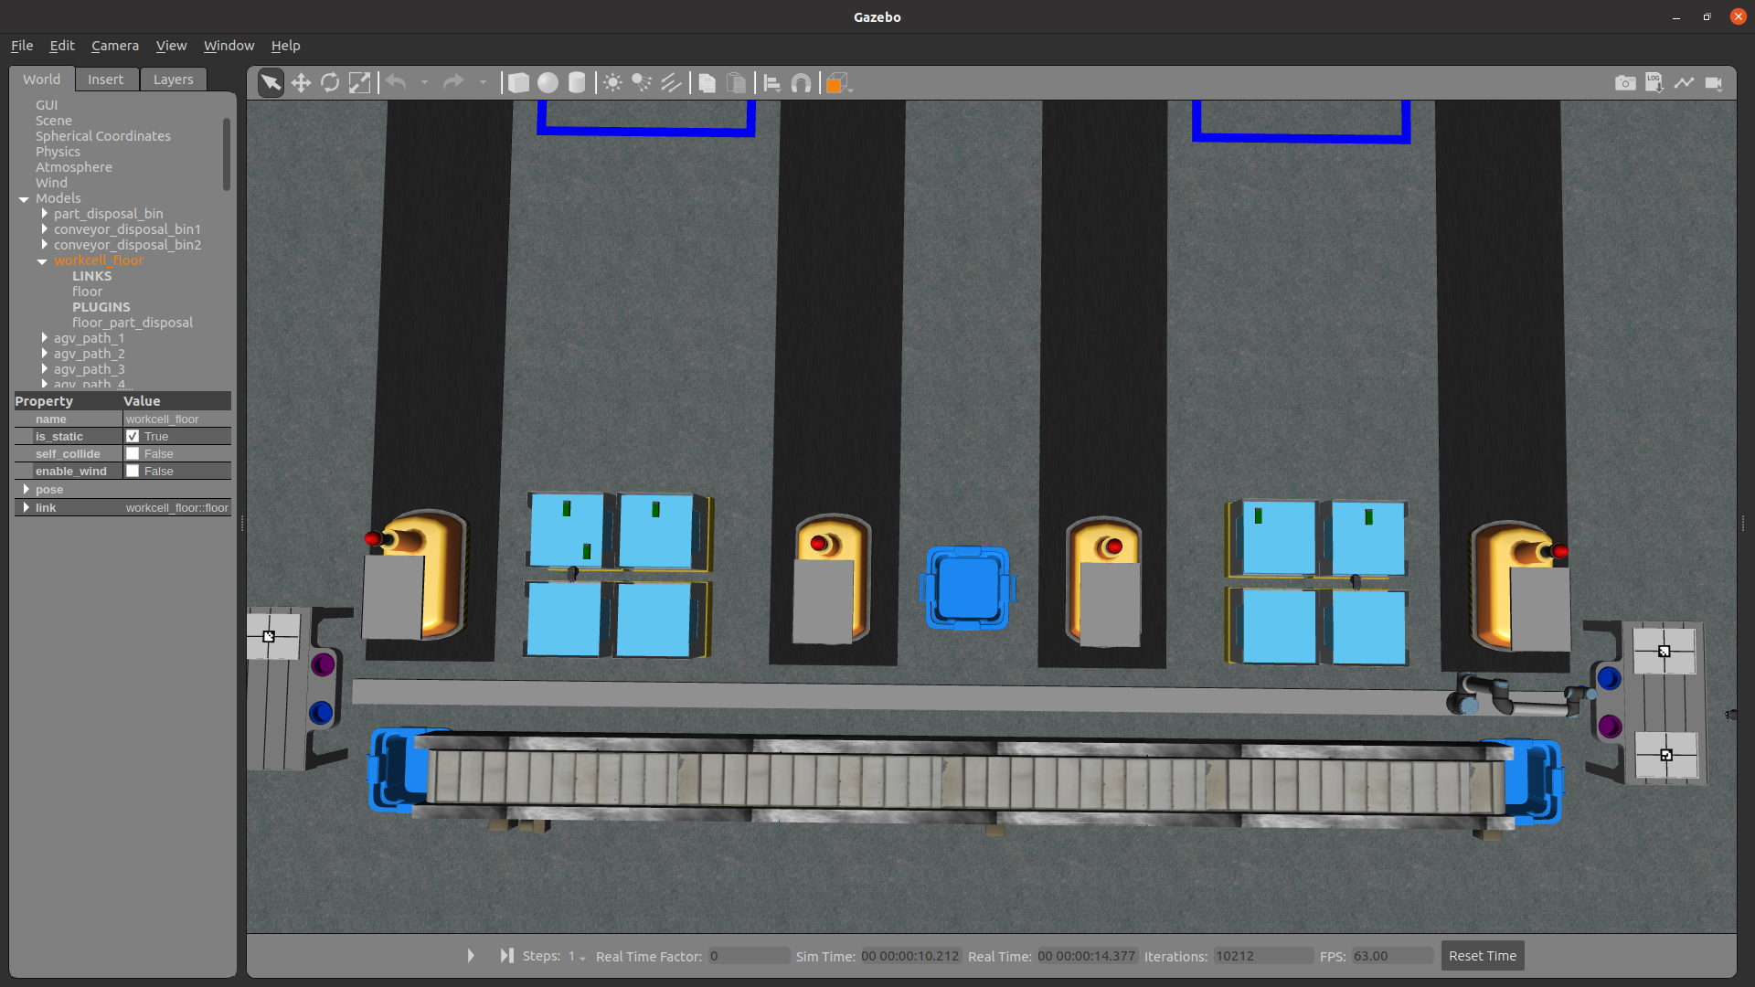
Trial Files:
The Order Manager node is the heart of the competition package:
rwa67_summer2023.yaml
rwa67_summer2023_SB_test1.yaml
4 orders
Multiple Faulty Parts
Insufficient Parts
rwa67_summer2023_TS_test1.yaml
Order contains 3 faulty parts
and only 5 available
Testing: faulty parts lead to missing parts
Notes:
Shreejay

Slide 11
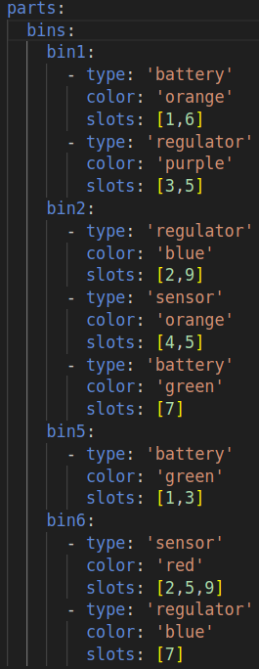
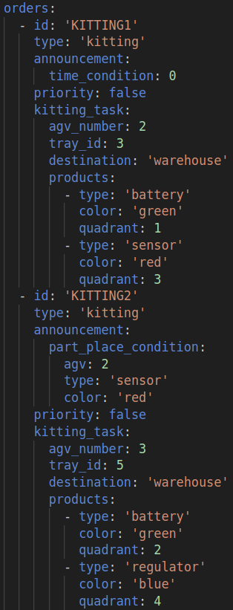
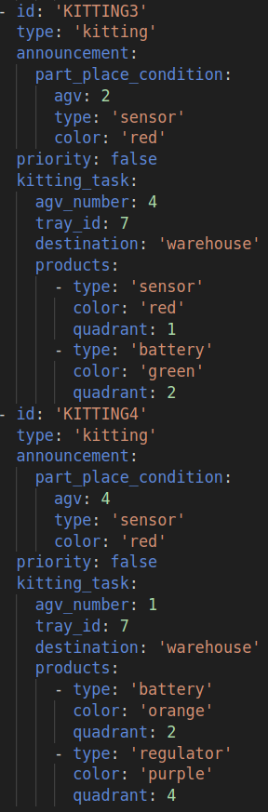
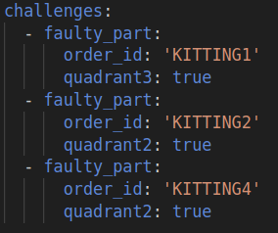
rwa67_summer2023_SB_test1.yaml
Notes:
Shreejay

Slide 12
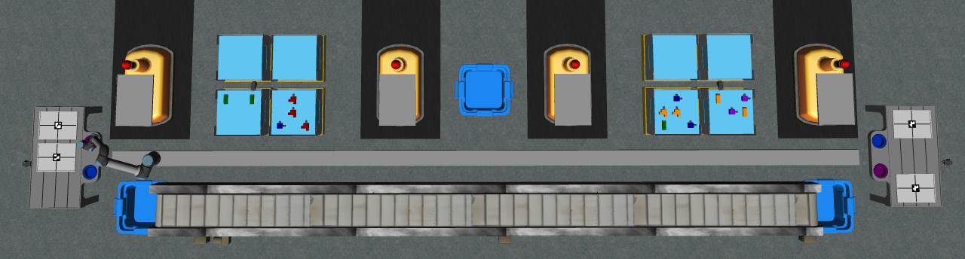

Slide 13
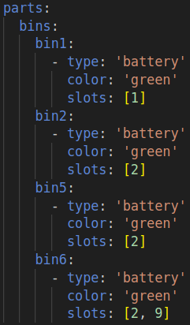
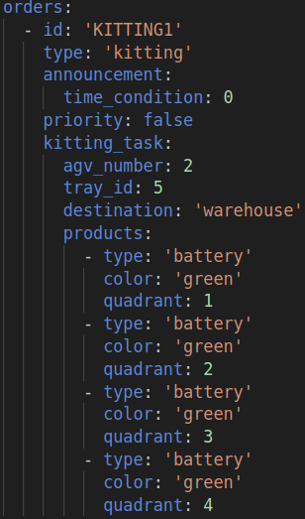
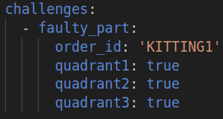
rwa67_summer2023_TS_test1.yaml
Notes:
Shreejay

Slide 14
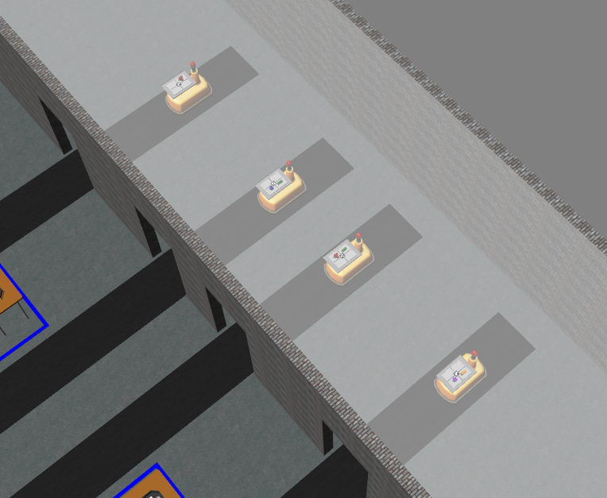
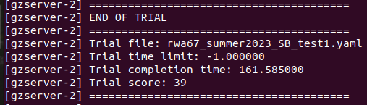
Result:
rwa67_summer2023_SB_test1.yaml:
completion time: 162 sec
Score: 39
Notes:
Shreejay

Slide 15
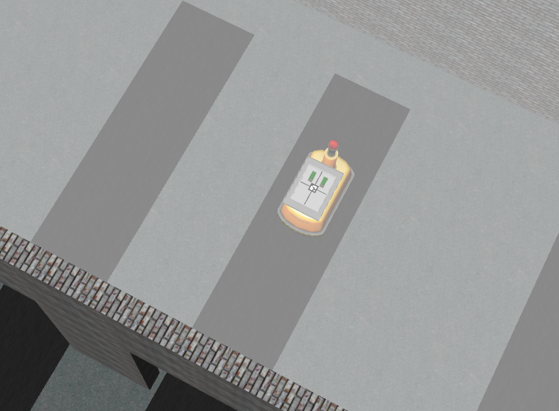
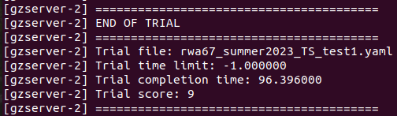
Result (cont.):
rwa67_summer2023_TS_test1.yaml:
completion time: 97 sec
Score: 9
Notes:
Shreejay

Slide 16
Challenges Faced:
Numerous obstacles were faced during this project such as:
Building a robust control architecture to handle challenges in orders.
Parsing camera data to manager the order providing by the competition.
Writing servers and using appropriate services to perform Kitting task in Gazebo environment.
Breaking down services for a smoother simulation.
Establishing appropriate communication between servers (written in C++) and clients (written in Python).
Notes:
Tim/Shreejay

Slide 17
Challenges Faced (cont.):
Fine tuning parameters in server callback methods for the floor robot to perform pick and place task for various parts and tray.
Ensuring parts were properly added to planning scene before attempting to interact with them.
Adjusting waypoints and targets to avoid collision with objects not in planning scene (objects still in bin).
What to snack on at midnight when floor robot goes rogue, dancing on the rail.
Notes:
Tim/Shreejay

Slide 18
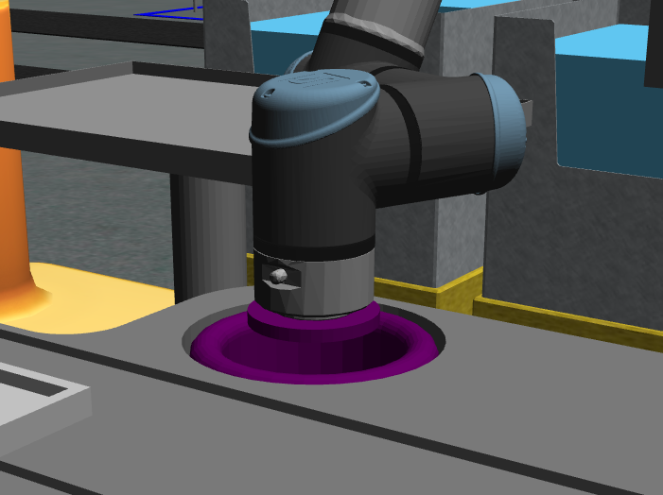
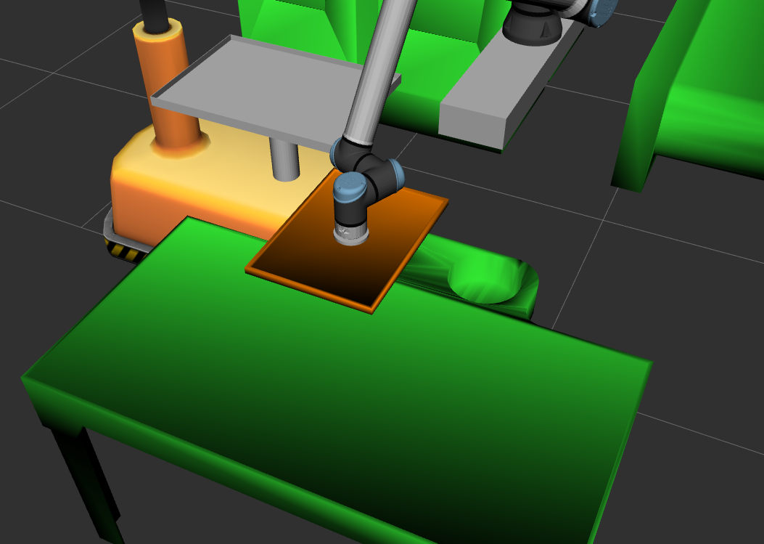
Challenges Faced (cont.):
Robot would not enter gripper changer because the planning scene still had the tray attached.
Notes:
Tim/Shreejay

Slide 19
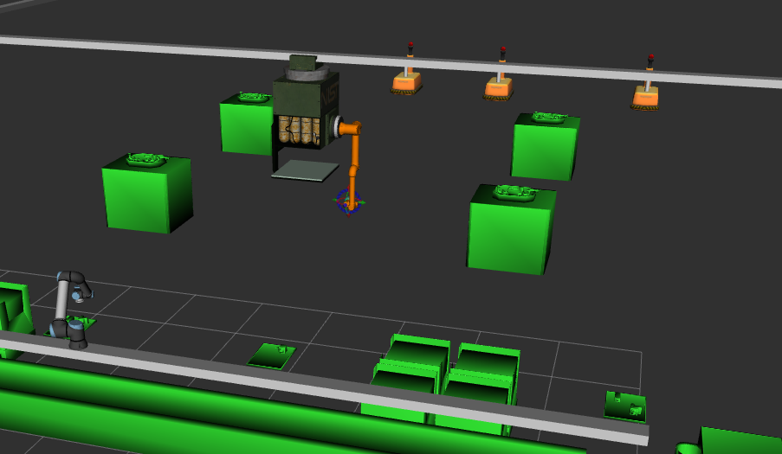
How can the results be made better?
Tray and Part inventories are determined at start. Ideally, part and tray locations should be continuously updated (bumped parts, dropped parts)
Integrate ceiling robot to reach all parts in bins
Attach trays/parts to AGVs in planning view. Current implementation would cause collisions when using the AGV for a second time.
Finish Priority order logic
Notes:
Dinesh

Slide 20
Conclusion
The ‘rwa67’ accomplishes its objectives:
Perform motion planning to complete up to 4 orders
1 per AGV
Cater for insufficient parts & faulty parts
Notes:
Dinesh

Slide 21
Demo:
Build the packages:
cd ~/ariac_ws/
colcon build --packages-select robot_msgs
colcon build --packages-select rwa67
Launch:
ros2 launch rwa67 rwa67_app.launch.py

